Slide 1
Dedupe, Merge and Purge
The Art of Normalization
Tyler Bell & Leo Polvets
@twbell @leopolvets
Notes:
First I’ll be introducing you to 'our data', telling you a bit about the problem we're trying to solve, why these problems require solving, and discussing our solutions. The idea here is to introduce – from a heavily data-centric perspective – the technological and busiess approaches we are taking to creating an Internet of Entities, and why this is important. All in 40 minutes.

Slide 2
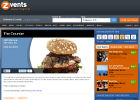

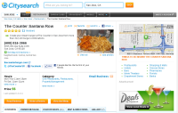
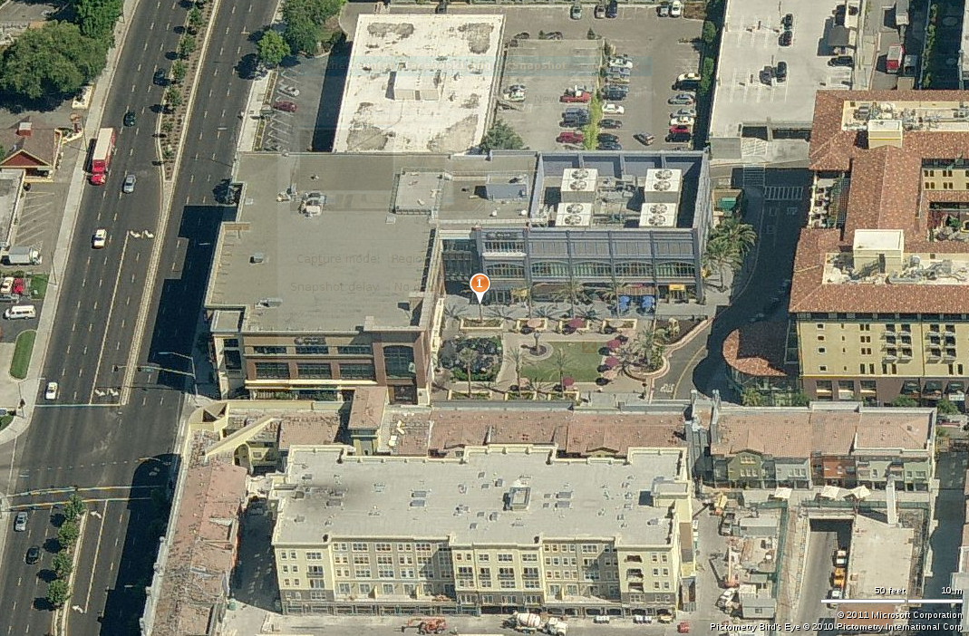
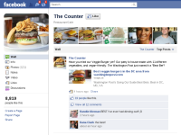
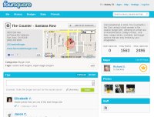
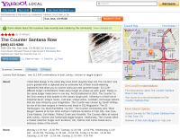
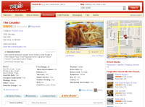

Notes:
‘The Counter’ is a physical place:
a member of a chain with the same name
represented electronically in 000 different places on the Internet

Slide 3
Two Problems:
An over-abundance of data
This same over-abundant data is
  Partial
  Erroneous
  Heterogenous
  Duplicated
  Untrustworthy
  Poorly typed

Slide 4
The Big Data Metaphor
Notes:
(Side Note: conferences like this are a great place to source metaphors as data scientists and others attempt shape with familiar language concepts and scopes both unfamiliar and at-times otherwise unfathomable. This talk will be no exception.)

Slide 5
Metaphorically:
If our source data were a person, it would be a curiously-dressed, absentminded, oracular but at-times-unintelligible sociopathic hermaphrodite who excels at practical jokes.
Notes:
If our source data were a person, it would be a curiously-dressed, absentminded, at-times-unintelligible sociopathic hermaphrodite who excels at practical jokes. (Difficult to find adequate clip art to express this individual)

Slide 6
The Bullhorn
Notes:
Generally content distribution on the Internet is a bullhorn, designed to amplify and distribute signal above the voices of others. Practically, someone like Yext will accept authoritative changes from an entity (such as a brand or an SMB) and perpetuate this information out (in a timely manner) to search engines, application developers, and portals. Each one of these entities assigns its own identifier and URL, infrequently (if ever) maintaining identifiers of the original contents. The resultant entites can be identified only by their collective attributes.

Slide 7
Why This is a Bad Thing
Notes:
[Provide use-cases here:
Social media aggregation/sentiment analysis
Mobile payments
Generally developing an understanding of Things outside specific verticals. This is all about bridgeing walls between silos.

Slide 8
SEM doesn't help
Goal of SEO is to (politely of course) ensnare eyeballs
SEM is based on broadcast and content multiplicity
Notes:
Search Engine Marketing is of course designed to pull eyeballs in (via links) by getting data out (again via links).

Slide 9


“With a single click you can recommend that raincoat, news article or favorite sci-fi movie to friends, contacts and the rest of the world”
Notes:
Social engagement is with the web page, not the underlying entity
http://googleblog.blogspot.com/2011/06/1-button-for-websites-recommend-content.html

Slide 10
“With a single click you can recommend that raincoat, news article or favorite sci-fi movie to friends, contacts and the rest of the world”
Notes:
http://googleblog.blogspot.com/2011/06/1-button-for-websites-recommend-content.html

Slide 11
“With a single click you can recommend that Webpage to friends,
contacts and the rest of the world”
Notes:
http://googleblog.blogspot.com/2011/06/1-button-for-websites-recommend-content.html

Slide 12
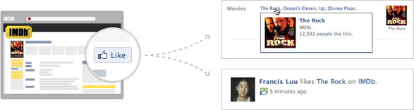
Webpage URLs are Entity URIs
http://developers.facebook.com/docs/opengraph/
Identifiers for people, places, things
Notes:
The Semantic Web community appears to hold a harmful obsession with formats and protocols. Almost any URL can serve as a URI, and be dereferenced to its attributes which may be structured in hcard, og, microdata, etc.

Slide 13
The Crucible
Notes:
Crucibles: melting pot where impurities are burned off leaving only a pure element behind

Slide 14
Canonical Data
Notes:
Canonical Data – entities that represent the 'pure' representation of our multiplicity of entities. However pure, these remain representations however.

Slide 15
factual_id: the Factual ID
name: Business/POI name
po_box: PO Box. As they do not represent the physical location of a brick-and-mortar store, PO Boxes are often excluded from mobile use cases. We’ve isolated these for only a limited number of countries, but more will follow
address: Street address
address_extended: Additional address incl. suite numbers
locality: City, town or equivalent
region: State, province, territory, or equivalent
admin_region: Additional sub-division, usually but not always a country sub-division
post_town: Town employed in postal addressing
postcode: Postcode or equivalent (zipcode in US)
country: The ISO 3166-1 alpha-2 country code
tel: Telephone number with local formatting
fax: Fax number formatted as above
website: Authority page (official website)
latitude: Latitude in decimal degrees (WGS84 datum). Value will not exceed 6 decimal places (0.111m)
longitude: as above, but sideways
category: String name of category tree and category branch
status: Boolean representing business as going concern: closed (0) or open (1) We are aware that this will prove confusing to electrical engineers
email: Contact email address of organization
Notes:
Factual's Global Places Schema

Slide 16
It's All About Typing, These Days
15 attributes x 44 countries = 660 attribute types
Often domain-specific
Required for extraction, verification
Notes:
15 attributes x 44 countries = 660 attribute types. These are required for both extraction and data verification, and are often (until the advent of microformats) domain-specific.

Slide 17
Entropy
Things fall apart, the center cannot hold…
State code: Low entropy
  Two entites with Same: Tells us very little
  Two entites with Different: Tells us very much
Zip code: as above, but artifact postal code formatting in some countries can convey elements of proximity.
Phone number: High entropy but surprisingly uninformative.
Notes:
State code:
Two entites with Same: Tells us very little
Two entites with Different: Tells us very much
Zip code: medium number of possible values, closeness of two zip codes tells you a little bit about two values (Two records in the same zip code might be the same, in two different zip codes that are close together)
Phone number: High entropy but surprisingly uninformative. Different numbers might not mean anything (some businesses have multiple phone numbers). Equal phone numbers might mean two places are the same, or it might mean they are in the same mall or owned by the same parent company or something else.

Slide 18
15 attributes x 44 countries (so far) = 660 attribute types
Notes:
15 attributes x 44 countries (so far) = 660 attribute types

Slide 19

The Ultimate Union of Man and Machine
http://www.fondos-hq.com/upload/DesktopWallpapers/cache/Futurama-fondos-Caricaturas-HQ-dibujos-animados-futurama-caricaturas-1024x768.jpg
Notes:
Lucene and Solr have given us excellent tools to improving how we access data. This is good, but creating genuine data-centric intelligence demands we remove the human from the equasion.

Slide 20

US Local Dataset
17.5m entities
pointing to over…
1.5b references
found across…
4.7m domains

Slide 21
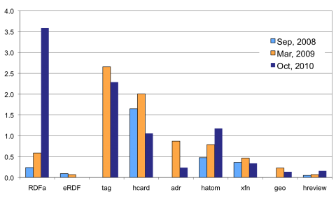
Peter Mika, Jan 2011
http://tripletalk.wordpress.com/2011/01/25/rdfa-deployment-across-the-web/
Notes:
“This chart shows the deployment of certain microformats and RDFa markup on the Web, as percentage of all web pages, based on an analysis of 12 billion web pages indexed by Yahoo! Search” http://tripletalk.wordpress.com/2011/01/25/rdfa-deployment-across-the-web/

Slide 22
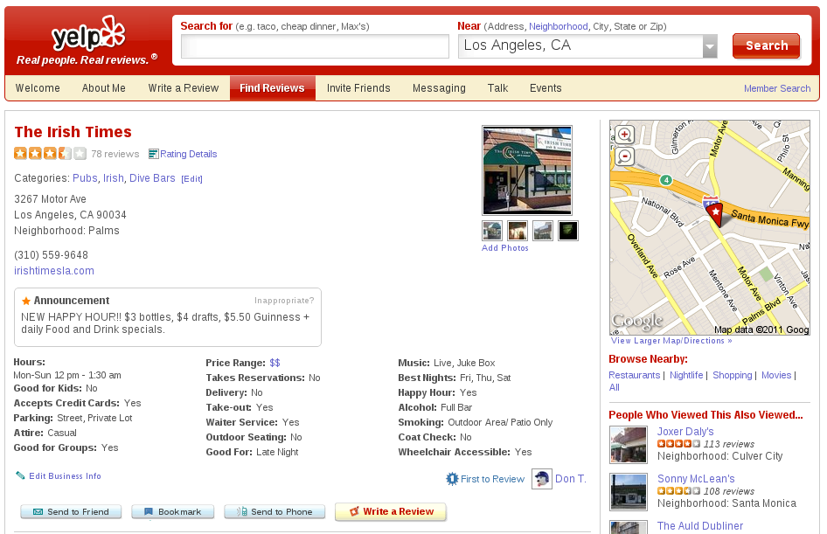
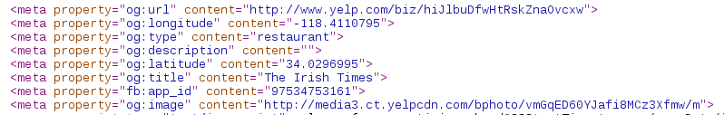
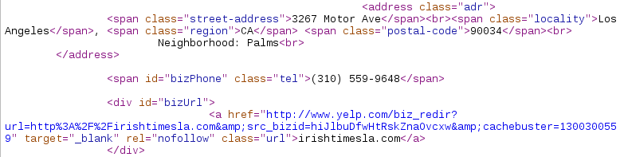
http://www.yelp.com/biz/irish-times-san-francisco-2
Notes:
Yelp pages are marked up in both og and hcard. All good, and equally consumable.

Slide 23
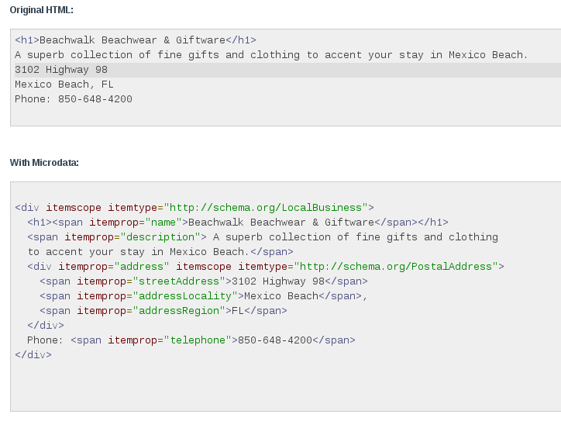


Slide 24



enable publishers to give us hints about what things they are describing on their sites… markup [will] amplify the value [webmasters ]receive in return
improve how their sites appear in major search engines… powering richer search results and new kinds of applications.
improve the search experience… alignment between search and our Web of Objects program
Notes:
The PR on schema.org focuses on Search, but each of these orgs is certainly working on an entity-mapping product, of which only Yahoo makes reference.
http://www.bing.com/community/site_blogs/b/search/archive/2011/06/02/bing-google-and-yahoo-unite-to-build-the-web-of-objects.aspx
http://googleblog.blogspot.com/2011/06/introducing-schemaorg-search-engines.html
http://www.ysearchblog.com/2011/06/02/introducing-schema-org-a-collaboration-on-structured-data/

Slide 25
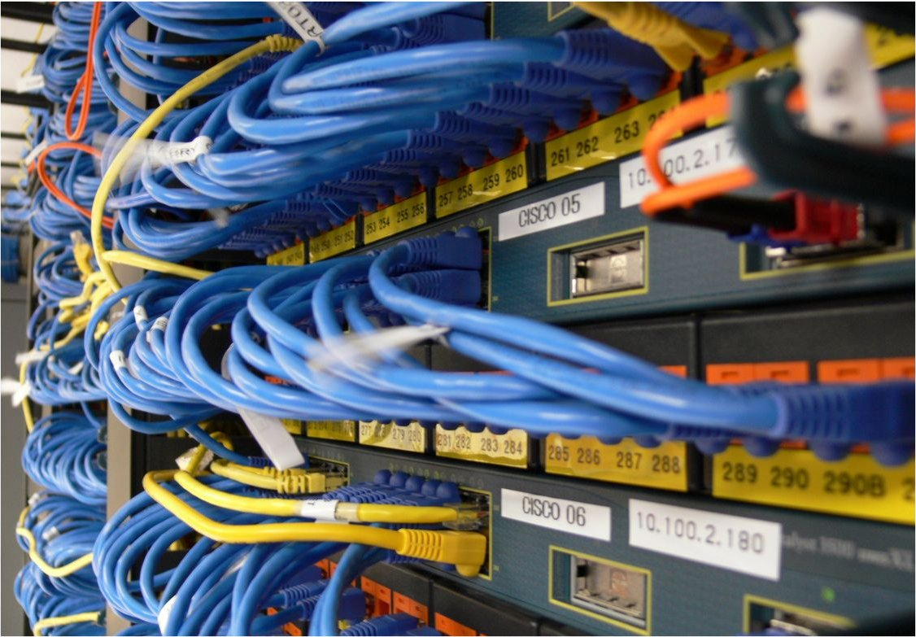
Datawire
TL;DR:
Search: human disambiguation is expected
Few inputs leads to ‘pull’, not ‘push’
Plurality of content is a real bugger
The Good News:
Content markup will do more than improve the look of search results
Increased recognition of machine-to-machine APIs
The socially networked world demands understanding across caissons
http://www.flickr.com/photos/tigerplish/250836258/
Notes:
Wires can connect

Slide 26
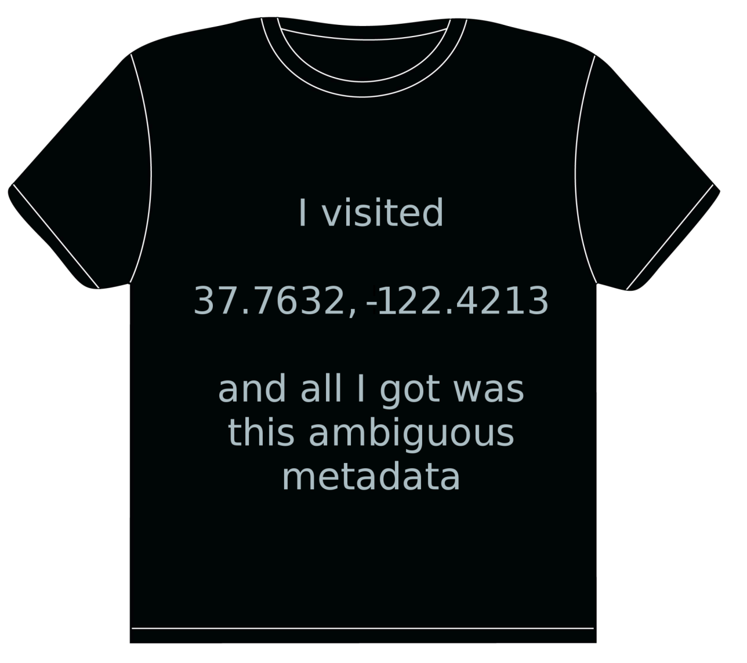

Tyler Bell
@twbell
Notes:
Fin.

